Slide 1

TMWA Arrowcreek Booster Pump Station
Special Use Permit
Board of Adjustment – May 7, 2020

Slide 2
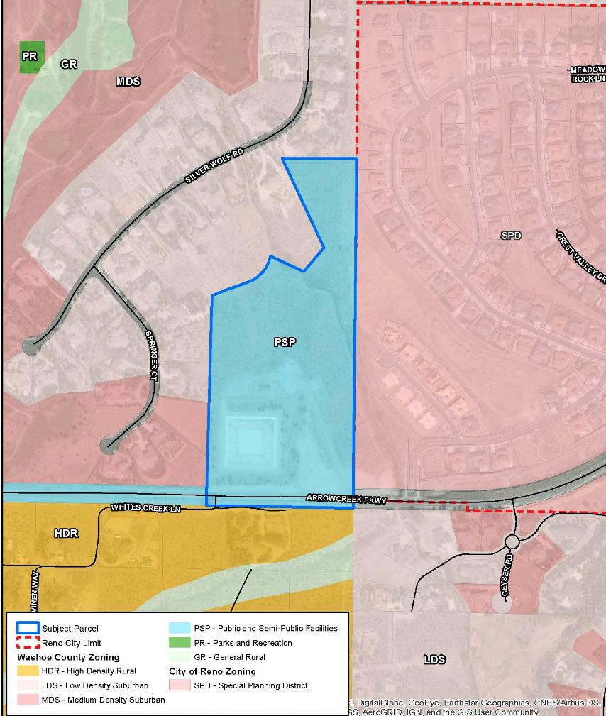
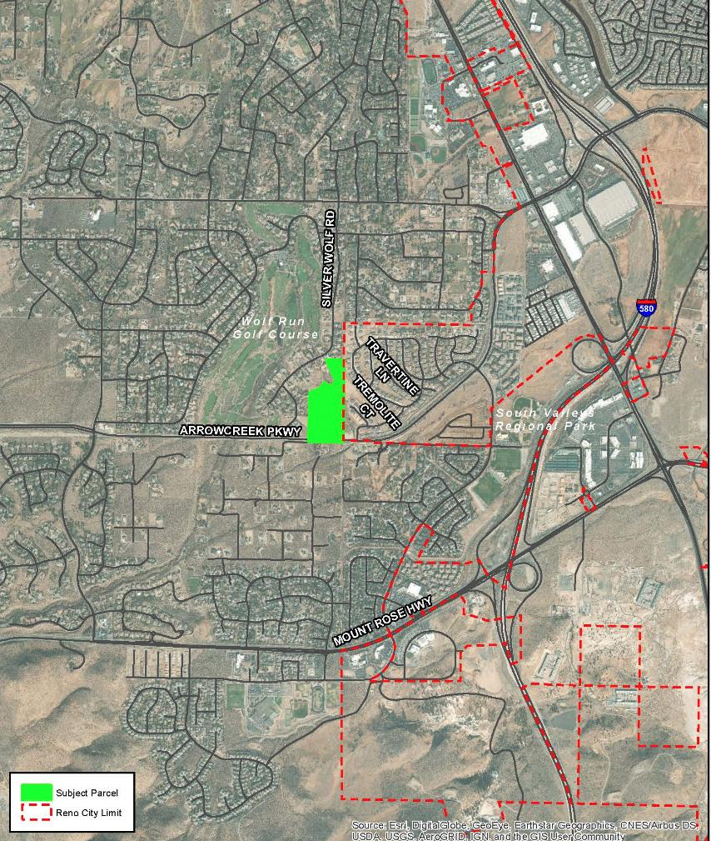

Project Area
APN 142-020-06
±24.48 Acres

Slide 3
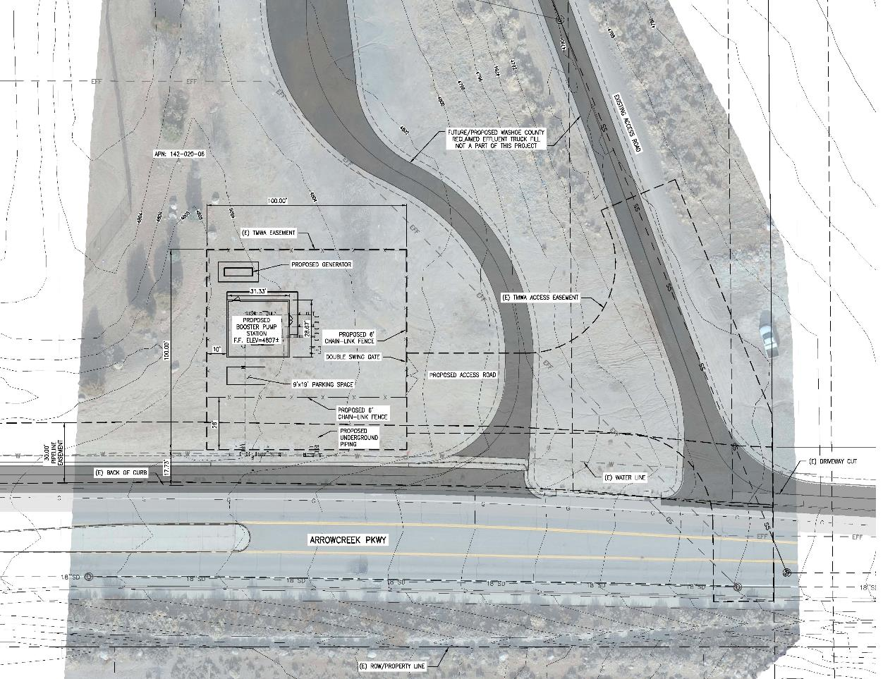
Project Request
Special Use Permit for Utility Service
Variance for paving of proposed access road

Slide 4
Project Request
Special Use Permit for Utility Service
  Washoe County grants TMWA easement for water facilities and access
  Proposed project designed within easement parameters and coordinated with Washoe County Utilities to accommodate a future Truck Fill Station on northern portion of site
  Proposed project on 10 x 10 paved pad with one parking space; secured with 6’ fence around perimeter
  28’ between fence and edge of easement will include underground piping to connect to existing water line in Arrowcreek and landscape screening along Arrowcreek

Slide 5
Project Request - Paving
Variance for paving of proposed access road
Easement Boundary
Area to be Paved by TMWA
Area of Aggregate Base by TMWA
Proposed Rocked Truck Entrance

Slide 6
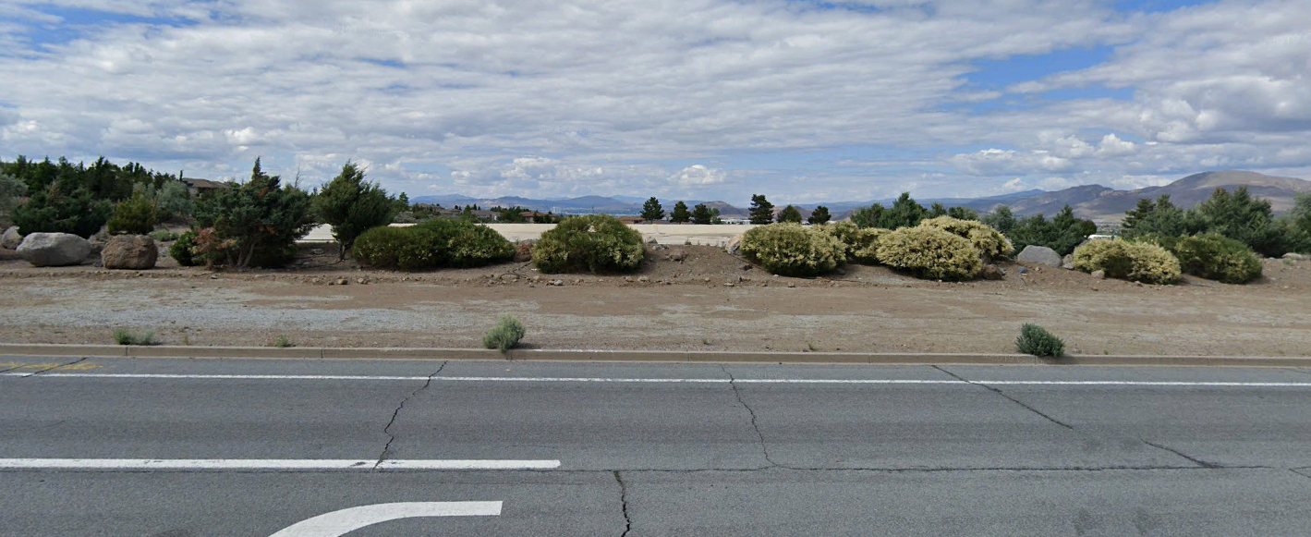

Existing “berm” along Arrowcreek Parkway
Note that basin is built below grade
Berm is less than 2’ tall and doesn’t really screen basin
Existing Screening Condition

Slide 7
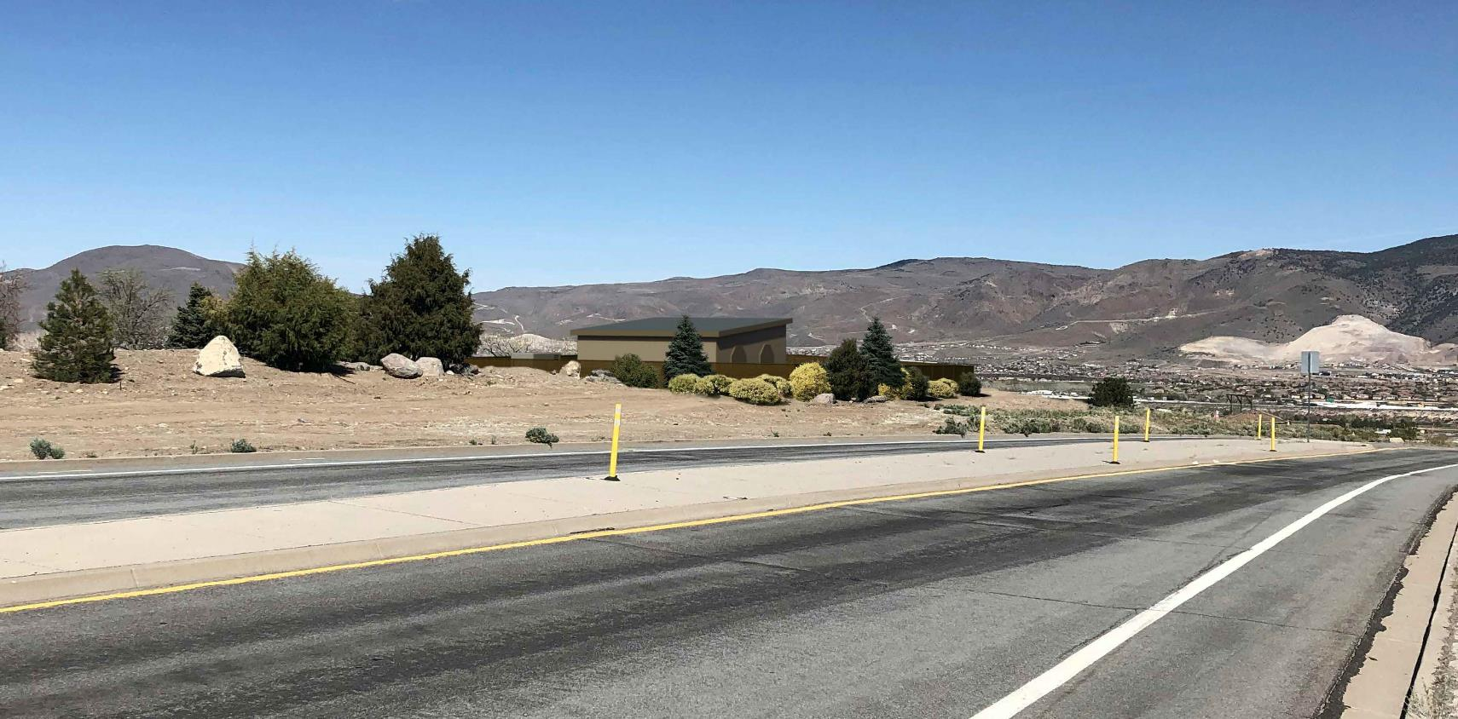
Note landscaping proposed along Arrowcreek Parkway is consistent with existing landscaping at adjacent Washoe County facility
Proposed Screening Conditions

Slide 8
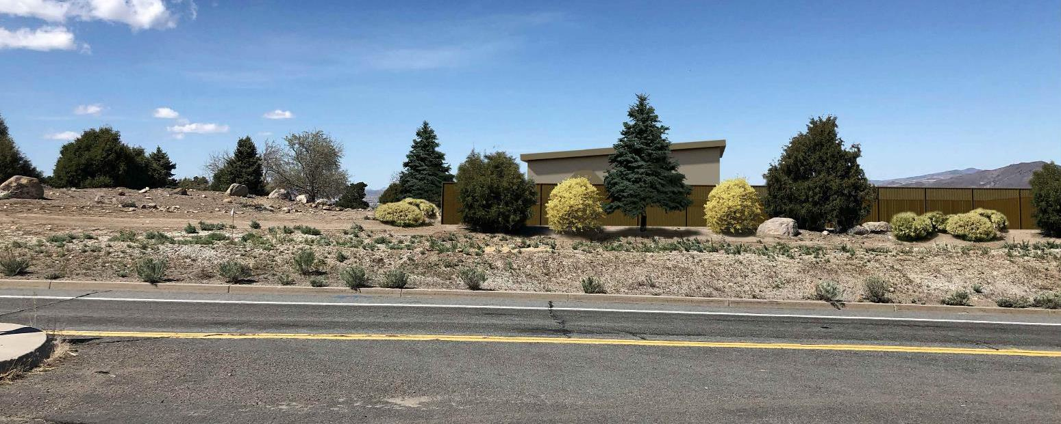
Consider modifying condition 1(d) to remove requirement for a “berm” but require enhanced landscape as shown here to screen facility:
  “The applicant shall submit landscape plans that include extending the existing landscape berm (located to the west of the project site) across the width of the south side of the project area, and as possible, along the east of the project area. The landscape berm shall continue the vegetation and tree pattern as the existing berm landscaping west of the site. The landscape plans shall meet all otherwise applicable provisions of Article 412 of the Washoe County Development Code.”
Proposed Screening Conditions

Slide 9
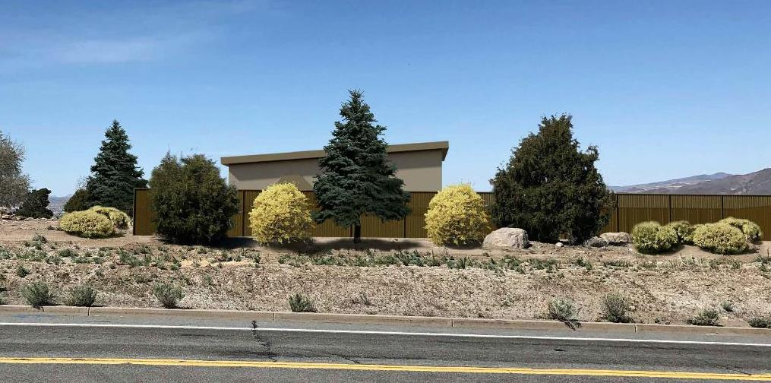
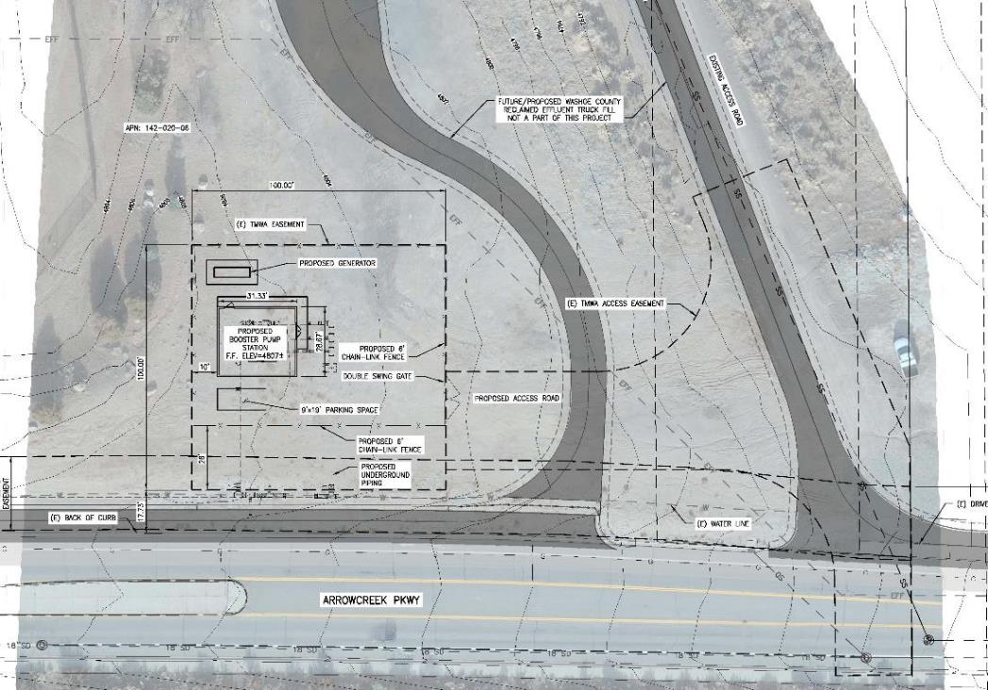
Closing

